Slide 1
Java overview
History and structure

Slide 2
Oak – the beginning
Started in 1990 as an internal project of Sun Microsystems to create a
small
reliable
portable
distributed
real time
running environment

Slide 3
Java design aims
Based on analysis of software distribution and running environments:
simple – reduced feature set, familiar instructions and syntax
secure – security built into the language and the running environment
high performance – cached interpreter, low priority memory management
reliable – check at compile and run time, simple memory model, OOP
multiplatform – virtual machine executes byte code

Slide 4
Java
Advantages
Disadvantages
Platform independent development
Platform independent execution
Unified code optimizer
Unified memory management
Readable code (no pointers)
Requires a running environment
Slower than native code execution
Reduced feature set
Restricted memory access

Slide 5
Java Platform – structure
Java Development Kit
java, javac, … development tools
Java Runtime Environment
Java Virtual Machine
JIT interpreter
Garbage Collector
Thread synchronizer
Class loader
Byte Code verifier
Runtime libraries
Java API

Slide 6
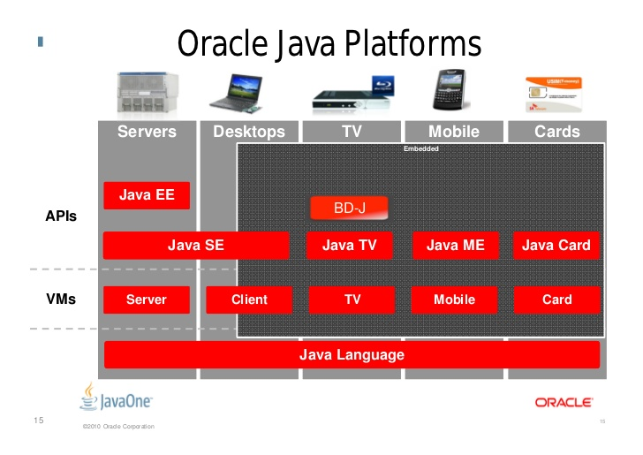
Java platforms

Slide 7
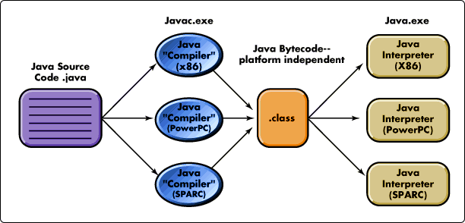
Compilation of a Java source code

Slide 8
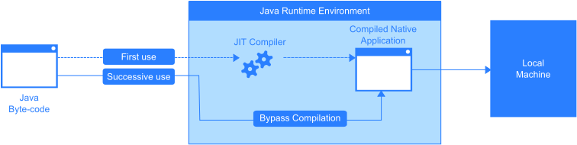
Execution of a Java program

Slide 9
Basic language components – Java
Variables, types, type casts
Custom types: enums, structs
Arrays, strings, constants
Operators, operator overload, precedence
Control statements
Code modules (functions), parameters
Dynamic memory management, data references
Function pointers – Method references

Slide 10
Variables
Like in any other programming languages, they are named memory storage units
Content is subject of change (if developer does not make otherwise)
Scope is the declaring code block

Slide 11
Types
Primitive types
Numeric
8, 16, 32, 64 bit integer and floating point
unsigned modifier disappeared
Character– 16 bit positive integer, one single piece of unicode character
Boolean – independent type can not be converted to int, values: true/false

Slide 12
Reference types
Reference type variables are like C pointers
Replaces pointer type
When creating a reference, no data storage allocation is done (only for the reference) That has to be done independently and the reference has to be set to the new allocation
Compiler tracks the type of the reference and matches to type of allocated area
Details of design, creation and syntactical rules later…

Slide 13
Objects
Everything other than primitive type is an object.
Primitive types can be wrapped into objects
Basic components of a Java (object oriented) program
Contains data and operations
Based on these above, they have custom type, called class

Slide 14
User defined types
With well designed objects, everything is possible, so Java does not contain
typedef, define, preprocessor
struct, union
enum

Slide 15
Type casts
Implicit type cast
Compatible type to bigger storage space
Compatible type to smaller storage space is NOT ALLOWED
Casting classes later…
double length = 5;
int length = 5.0; //Invalid

Slide 16
Type casts
Explicit type cast
Compatible type to smaller storage space with explicit target type specification
double length = 5;
int height = (int)length/2;

Slide 17
Arrays
Collection of items if same type
Not a primitive type → object
Can be created from any type (even from Object)
Can be created from array → multi dimensional or nested arrays
Items accessed by indexer: []
Can not be indexed like C pointers
Items have to be initialized one-by-one

Slide 18
Array initialization
// <type>[] <variable name> = new <type>[<item count>];
int[] numbers = new int[12];
// <type>[] <variable name> = new <type>[] {<items>};
int[] numbers = new int[] {1, 2, 3, 4, 5};

Slide 19
String type
Not a primitive type → object
All string data is handled by String objects
Not a character array with terminal
A String object is immutable, on change, a new object is created
The compiler handles texts between ”” as String objects
String name = ”Tamas”;

Slide 20
Operators
Next to the known arithmetic, logical and relational operations, Java has
>>> logical right shift
+ (concatenation) of Strings
Built in operators can not be modified
Operators can not be created for custom classes (objects)

Slide 21
Control statements
Sequence, code block like in C. ”;” and ”{…}”
if, for, while, do-while like in C
foreach – loop through iterable collections without explicit indexing
Deep nested break and continue
No goto

Slide 22
Methods, parameters
Not independent components, parts of objects
Declaration like in C
<return type> <method name>([formal parameters])
{
<method body>
}

Slide 23
Method parameters
All parameters are passed by value
Also reference type variables (like in C)
Value of reference is the address of referenced region, therefore caller and method work on the same allocated area.

Slide 24
Dynamic memory management
Heap is managed by JVM
Programmer creates references
On instantiation, JVM allocates memory for the object, sets the reference
JVM counts references to objects, if an object has no valid reference, it is a subject of removal (garbage collection)

Slide 25
Method references
Java has multiple technique
Reference type: Function<Parameter_types, Return_type> func;
Anonymous class – later
Lambda expression – later
Method reference: <context>::<method name>
func = newCustomer::calculateWage;

Slide 26
Using objects
Java is a strongly typed and object oriented language, therefore developers have to create and use objects.
Class (template) declaration: class keyword
Instantiation: new keyword
Details later…

Slide 27
Using objects
class <class_name> {
[data_member(s)]
[method(s)]
}
User guest = new User();
guest.firstName=”Tamas”;
class User {
public String firstName;
public String lastName;
public String getName() {
return lastName +” ”+firstName;
}
}

Slide 28
Console
Without interpretation, use these to access console in terminal applications
Print data to console:
System.console().writer().println(”Hello!”);
Read data from console:
String str = System.console().readLine();
Details later…

Slide 29
Console - IDE
Using a IDE, terminal is not accessible, but still able to use developer console.
Without interpretation, use these to access console in terminal applications
Print data to console:
System.out.println(”Hello!”);
Read (scan) data from console:
Scanner scanner = new Scanner(System.in);
int i = scanner.nextInt();
Details later…

